Slide 1
Plug-In architectures
Tobias Freudenreich
Notes:
Mention plug-in and plugin

Slide 2
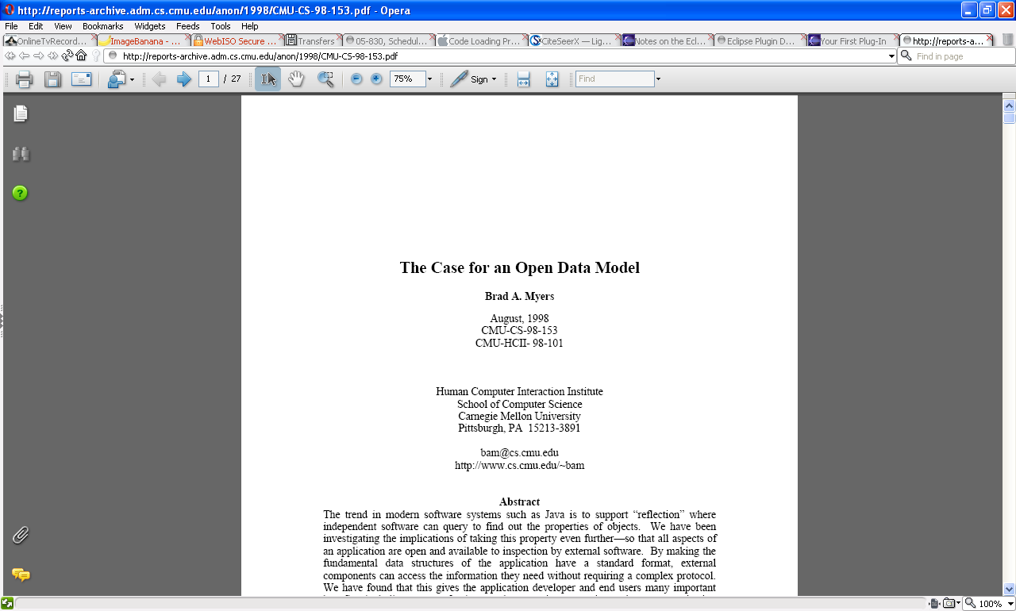

Slide 3
Definition
What is a plug-in?
“a small piece of software that supplements a larger program”
Merriam-Webster’s Online Dictionary
“An accessory software or hardware package that is used in conjunction with an existing application or device to extend its capabilities or provide additional functions”
- The Free Dictionary

Slide 4
Definition
Some differentiate between an extension and a plug-in
Plug-ins
  Rely on user interface
  Are limited in their set of actions
Extensions
  Can add new functionality and user interface elements
I will not make this distinction

Slide 5
Motivation
Keep software simple
  Switch “nice to have” features off
Modularity
Customizability
Extensibility
Resourcefulness
Notes:
Modularity: scale enterprise software to customer needs (basic, premium, ultra, …)
Customizability: new menu items/icons, own spell checker, etc.
Extensibility: add new functionality (new image formats); Example: Firefox: would it be as popular without plug-ins? Third-party developers, features not forseen

Slide 6
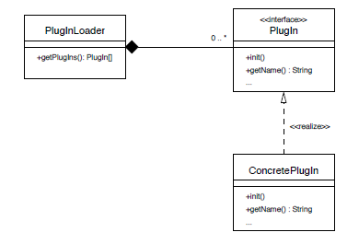
Plug-in architecture
Notes:
PlugInLoader: discovers plug-ins, load and initializes them, asks them for responsibilities and invokes them when appropriate
PlugIn: Interface for all plug-ins, protocol is specified here
ConcretePlugin: does things

Slide 7
Questions
How much control do plug-ins have?
What can plug-ins control?
How are plug-ins installed/discovered?

Slide 8
Traditional architecture
plug-in
plug-in
plug-in
host application
Notes:
Web browsers, graphical editors
Well defined interfaces

Slide 9
Pure plug-in architecture
plug-in
plug-in
plug-in
plug-in
plug-in
core engine
Notes:
Everything is a plug-in
Core engine is just for loading plug-ins, no other functionality
Plug-ins are hosts themselves, defining extension points for other plug-ins
Eclipse model

Slide 10
Challenges
Discovery
  Need to discover compatible classes after compile-time
  Even harder when plug-ins can be added at runtime
  Typically one designated path
    But: multi-user environments
Update
Security
Versions and Dependencies
Scalability
Easy development of new plug-ins
GUI changes
Notes:
Update: testing, configuration never known, different vendors
Security: arbitrary code from the web, even during installation of plug-in, support digital signatures (eclipse does); BUGS
Version and Dependencies: what to do to menu when there are two versions of the same plug-in
Scalability:
Up: start-up time, activate only on demand; installation choices
Down: core must also run on small devices
GUI changes: add a whole new settings panel?

Slide 11
Photoshop
Fixed set of plug-in types:
  Image filter, Import, Export, Parser, Extension, Format, Color picker, Selection, Automation
Scans for 'PiPL' (plug-in property list)
  Description of what the plug-in is and its preferences
Plug-ins have defined entry point (“main”)
  Called by Photoshop when needed
  Call includes a 200-field structure
Notes:
Preferences: preferred color model, image types,

Slide 12
Firefox (and other Mozilla products)
Distinction: Plug-ins and Extensions
Plug-ins
  Help browser display data (pdf, multimedia, etc.)
  Gecko Plugin API (NPAPI)
  Register for MIME-types
  Draw into browser, modify DOM
  Receive mouse and keyboard events
  Multiple instances per plug-in possible
Notes:
check for a plug-in with a matching MIME type
load the plug-in code into memory
initialize the plug-in
create a new instance of the plug-in

Slide 13
Firefox (and other Mozilla products)
Extensions
  Modify browser’s GUI (written in XUL and Javascript)
    XUL defines how the interface looks (static description)
    Javascript defines how it works (interaction description)
  .xul files define “merge points”
  Can attach more elements to these at run time
  Can also modify behavior
  Configuration files define all this
Notes:
Merge points: overlay own .xul file with a brower’s .xul file, so it gets loaded at the same time and is merged

Slide 14
Microsoft Office
Plug-ins discovered by registry entries
Can add things to the user interface
Have access to the Object Model
Can register callbacks for all kinds of events
Development inside of Visual Studio with VSTO

Slide 15
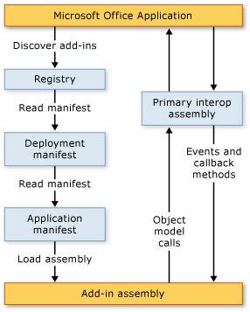
Microsoft Office
http://msdn.microsoft.com/en-us/library/bb386298.aspx

Slide 16
Eclipse
Eclipse is good for building IDEs
  But can do almost any application (including non-graphical)
Searches for plug-ins in a specific folder
Load on demand
Every plug-in has a description (manifest) file
Everything is a plug-in
Plug-ins extend other plug-ins
  Creates dependencies
Does not have to be UI related
Notes:
Some high level documentation
Often the only source is example source code

Slide 17
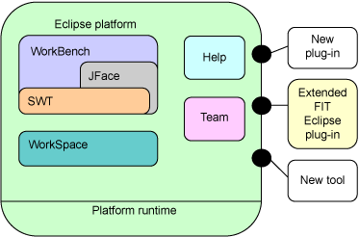
Eclipse
Source: www.imb.com

Slide 18
Summary
Plug-ins need to be at a specific location
Plug-in description file of some sort used
Generally, plug-in can modify displayed content after it is invoked
Plug-in gets control with callbacks
Each plug-in implements one or more previously defined interfaces

Slide 19
Open Data Model
Alternative how “plug-ins” can be realized
Idea: Expose application’s data structures in a standard format
  Not only persistent data
  Any data the application uses: main data, menu items, widgets, available operations, open network connections, etc.
  Allow inspection and modification
Notes:
Mention drawing program example

Slide 20
Open Data Model
Wait… we can do that already!
  Java: Introspection and Reflection
  OLE Automation
Not enough…
  Need some standards
    Names and data types
    Term: Examinability
  What is the behavior?
    E.g. “What happens if the user clicks at (x,y)”?
  Scriptability

Slide 21
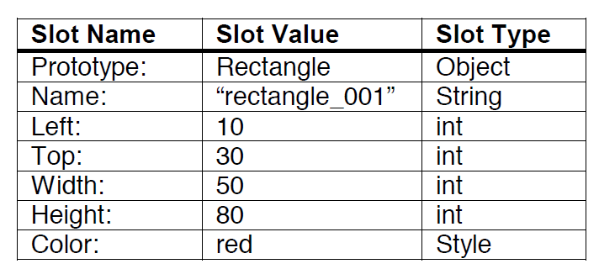
Open Data Model
One way to implement: attribute-value pairs
Require applications to use only this data structure and expose it
Amulet does this
All applications should use it: Toolkit support
Notes:
Amulet:
Objects all to query for all slot names and corresponding values and types
Behaviors can be inspected due to command objects

Slide 22
Benefits
Automation
Customization and Macros
Agents and Tutors
Rich searching
Checkers (spelling, size, etc.)
Alternative interfaces
Plug-in support
Support for programmers
Notes:
Automation: communication (enter less data)
Customization: change shortcuts, customization agent can be supplied by the toolkit
Macros: one application to record macros for all others
Agents and Tutors: guide user (Word’s “clippy”); change appearance (highlight menu item that might be useful)
Rich searching: one searching capability for all applications, including graphic search; can be supplied by toolkit
Alternative interfaces: interfaces for blind people, query available actions
Support: many things supported by toolkit: undo, debugging (inspection)

Slide 23
Concerns
Requires more memory
  Still a problem?
Difficult to realize
  Amulet shows that many things are possible
  Needs standardization
    How successful has standardization been so far?
Security
  Expose all the application’s data?
    Mechanisms for “private” fields could be added
  Might be easier to reverse engineer

Slide 24
Discussion
Sounds a lot like SOA, what is the difference?
How different are plug-in architectures from the Open Data Model
Which one would you choose if you made a new application?

Slide 25
References
Johannes Mayer, Ingo Melzer, Franz Schweiggert, "Lightweight Plug-in-Based Application Development". Revised Papers from the International Conference NetObjectDays on Objects, Components, Architectures, Services, and Applications for a Networked World. pp. 87 - 102, 2002.
http://citeseerx.ist.psu.edu/viewdoc/download;jsessionid=8420F871B0AD7881A077CEBC9392A509?doi=10.1.1.11.5602&rep=rep1&type=pdf
Brad A. Myers. The Case for an Open Data Model. Carnegie Mellon University School of Computer Science Technical Report, no. CMU-CS-98-153 and Human Computer Interaction Institute Technical Report CMU-HCII-98-101. August, 1998.
http://reports-archive.adm.cs.cmu.edu/anon/1998/CMU-CS-98-153.pdf

Slide 26
References
Birsan, D. 2005. On Plug-ins and Extensible Architectures. Queue 3, 2 (Mar. 2005), 40-46.
http://doi.acm.org/10.1145/1053331.1053345
Rubel, D. 2006. The Heart of Eclipse. Queue 4, 8 (Oct. 2006), 36-44.
http://doi.acm.org/10.1145/1165754.1165767
Notes on the Eclipse Plug-in Architecture: http://www.eclipse.org/articles/Article-Plug-in-architecture/plugin_architecture.html
Introduction to Eclipse Plugin development: http://www.eclipsepluginsite.com/
Your First Plug-in:
http://www.eclipse.org/articles/Article-Your%20First%20Plug-in/YourFirstPlugin.html

Slide 27
References
VSTO
http://msdn.microsoft.com/en-us/vsto/dd162433.aspx
http://www.mactech.com/articles/mactech/Vol.15/15.04/PhotoshopPlug-InsPart1/
https://developer.mozilla.org/en/Building_an_Extension
www.wikipedia.org

